Slide 1

JavaScript Development 101
DYNAMICS CRM/365

Slide 2

Mitch Milam
Dynamics CRM Architect
Independent consultant
Ten–Time Dynamics CRM MVP
Contact me:
mitch@xrmcoaches.com
Infinite–x.net
@mitchmilam

Slide 3
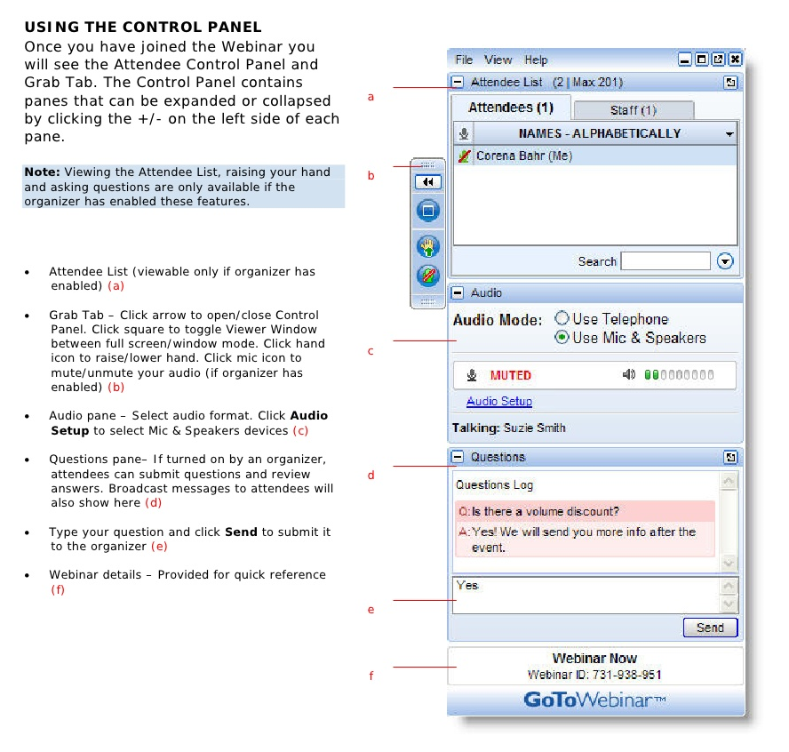
Webinar Housekeeping

Slide 4
Future Events
Workshop: Dynamics CRM Plugin Developer Workshop
Tuesday, March 22th - Wednesday, March 23rd.

Slide 5



2016 Training Roadmap
Webinars
http://www.xrmcoaches.com/webinars
KnowledgeBits
http://www.xrmcoaches.com/knowledgebits
Learning Plans
Coming soon
More Goodies
Practice tests
On–Demand video training
Instructor–led training
Books

Slide 6
Agenda
Setting up your toolbox
Working with JavaScript web resources
Working with Attribute and Controls
Working with Tabs and Sections

Slide 7
Getting Started
Tools
Dynamics CRM SDK
http://tinyurl.com/VS2013CommunityEdition
XrmServiceToolkit
http://xrmservicetoolkit.codeplex.com
CRM REST Builder
https://crmrestbuilder.codeplex.com
Visual Studio 2013/2015
CRM Solution Manager (commercial)
https://www.crmsolutionmanager.com

Slide 8
Getting Started
Setting up a development environment
Development server
Virtual machine
Sandbox instance (CRM Online)

Slide 9
JavaScript Web Resources
Contain individual JavaScript files which contain JavaScript functions
JavaScript functions are associated with Form and Field Events
Can contain functions associated with ribbon controls

Slide 10
Web Resource Design
One web resource per entity
One web resource per entity ribbon
Generic or utility web resources
Tool-specific resources: jQuery, JSON2

Slide 11
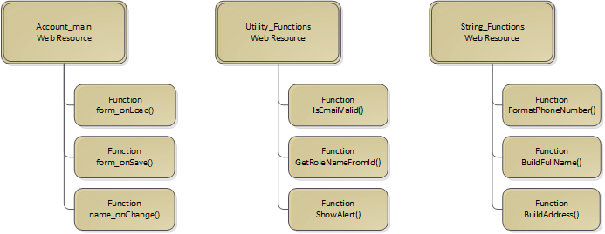
Web Resource Design

Slide 12
Web Resource Design
Naming Conventions
[entity]_main_library.js
Examples
Contact_main_library.js
Contact_ribbon_library.js
[entity]_ribbon_library.js

Slide 13
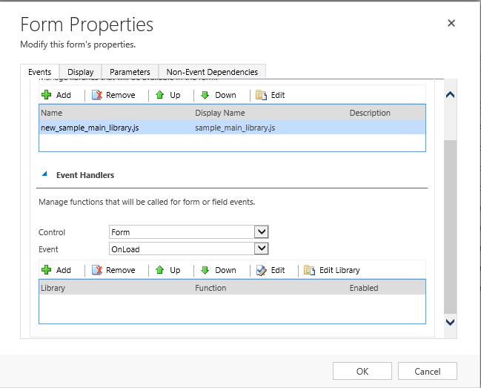
Form Libraries
Connects the Web Resource to the Form
Provides access to functions for use as event handlers
Up to 50 libraries per form

Slide 14
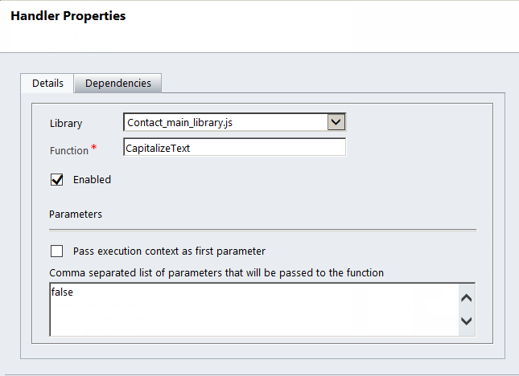
Event Handlers
Connect JavaScript Library functions with form events
Major Events:
OnLoad
OnSave
OnChange
Up to 50 event handlers per event

Slide 15
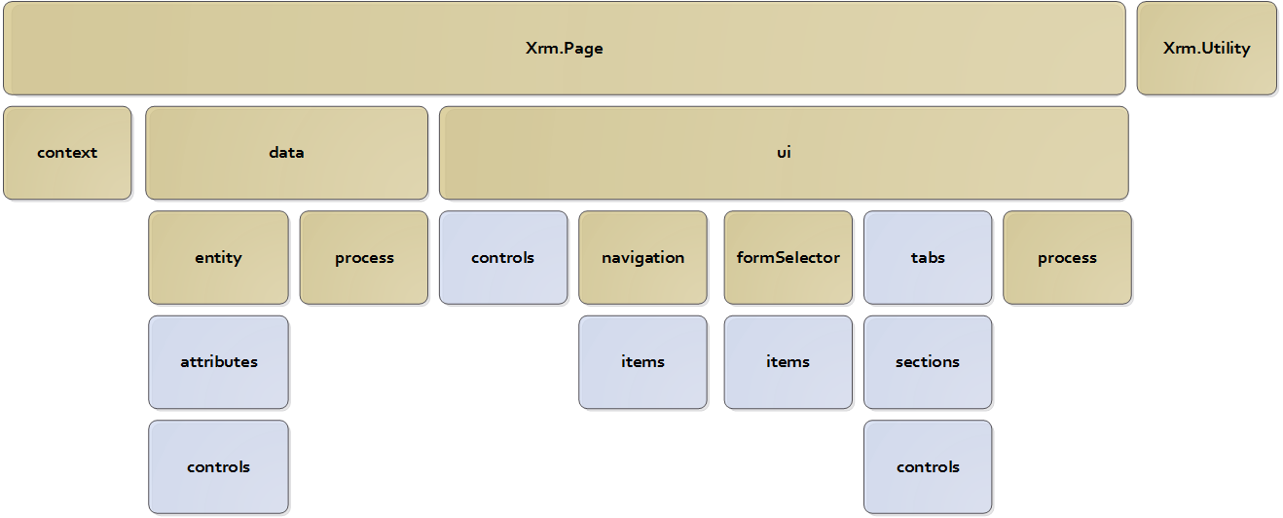
Dynamics CRM Object Model

Slide 16
Getting Started
CRM Form Fields contain two components:
Attribute (data)
Control (data entry control)
There is only one Attribute
Multiple Controls may exist for a single Attribute
Attributes and Controls each have specific Xrm.Page methods attached.

Slide 17
Getting Started
Connect to an Attribute:
Xrm.Page.getAttribute();
Connect to a Control:
Xrm.Page.getControl();

Slide 18
Working with Data
Methods for working with Data:
getValue()
setValue()

Slide 19
Working with Data
Methods for working with Data:
getValue()
setValue()

Slide 20
Form Field Overview
CRM Form Fields contain two components:
Attribute (data)
Control (data entry control)
There is only one Attribute
Multiple Controls may exist for a single Attribute
Attributes and Controls each have specific Xrm.Page methods attached

Slide 21
Xrm.Page Shortcuts for Fields
Connect to an Attribute
Xrm.Page.getAttribute()
Connect to a Control
Xrm.Page.getControl()
Notes:
This shows raw text information – use sparingly

Slide 22
Methods for working with Data
Data
Methods
getValue()
setValue()
setRequiredLevel()

Slide 23
Using the getValue Method
getValue()
Retrieves the value of an attribute
Arguments
None
var firstName = Xrm.Page.getAttribute("m3_firstname").getValue();

Slide 24
Data Types Returned by getValue
getValue() return data types
Field Type | CRM Attribute Type | JavaScript Type
Two Option | Boolean | Boolean
Date and Time | Datetime | Datetime
Decimal | Decimal | Number
Floating Point | Double | Number
Whole Number | Integer | Number
Lookup | Lookup | Array
Multiple lines of Text | Memo | String
Money | Money | Number
OptionSet | OptionSet | Number
String | String | String

Slide 25
Using the setValue Method
setValue()
Sets the value of an attribute
Arguments
Value
var firstName = Xrm.Page.getAttribute("m3_firstname").getValue();
var lastName = Xrm.Page.getAttribute("m3_lastname").getValue();
var fullName = firstName + " " + lastName;
Xrm.Page.getAttribute("m3_name").setValue(fullName);

Slide 26
Using the setRequiredLevel Method
setRequiredLevel()
Sets the requirement level of an attribute
Arguments
none
required
recommended
function makeActive() {
if (Xrm.Page.getAttribute("new_active").getValue() === true) {
Xrm.Page.getAttribute("new_firstname").setRequiredLevel("required");
Xrm.Page.getAttribute("new_lastname").setRequiredLevel("required");
}
else {
Xrm.Page.getAttribute("new_firstname").setRequiredLevel("none");
Xrm.Page.getAttribute("new_lastname").setRequiredLevel("none");
}
}

Slide 27
Xrm.Page.ui Control Methods
Control
Methods
setVisible()
setDisabled()

Slide 28
Using the setVisible Method
setVisible()
Retrieves the value of an attribute
Arguments
None
Xrm.Page.getControl ("m3_firstname").setVisible();

Slide 29
Using the setDisabled Method
getValue()
Retrieves the value of an attribute
Arguments
true Make field read-only
false Make field read-write
Xrm.Page.getControl("m3_firstname").setDisabled(true);

Slide 30
Xrm.Page.ui Tab Methods
setFocus()
setVisible()
setDisplayState()
Tab
Methods

Slide 31
Using the setFocus Method
setFocus()
Moves the focus of the form to a specific tab. If the tab is collapsed, it will be expanded.
Arguments
None
Xrm.Page.ui.tabs.get("general_tab").setFocus();

Slide 32
Using the setVisible Method
setVisible()
Sets the visibility of a Tab
Arguments
true Show the tab
false Hide the tab
Xrm.Page.ui.tabs.get("General_tab").setVisible(true);

Slide 33
Using the setDisplayState Method
setDisplayState()
Expands or collapses a Tab
Arguments
expanded Expands the tab
collapsed Collapses the tab
Xrm.Page.ui.tabs.get("general_tab").setDisplayState("expanded");

Slide 34
Xrm.Page.ui Section Methods
Section
Methods
setVisible()

Slide 35
Using the setVisible Method
setVisible()
Shows or hides a section
Arguments
true Show the section
false Hide the section
Xrm.Page.ui.tabs.get("general_tab").sections.get("addresses").setVisible(false);

Slide 36
Summary
Setting up your toolbox
Working with JavaScript web resources
Working with Attribute and Controls
Working with Tabs and Sections

Slide 37
Next Steps
Set up your tools
Read the Dynamics CRM SDK
Practice, Practice, Practice

Slide 38
Questions?

Slide 39
Thank You

